Slide 1
Chapter:4
Three Phase Induction motor

Slide 2
Introduction
The three phase induction motors are the most widely used electric motors in the industry.
They run at essentially constant speed from no-load to full-load.
Induction motor runs at a speed other than the synchronous speed, so it is called asynchronous motor.
Nevertheless, these, motors are simple, rugged, low-priced, easy to maintain and can be manufactured with characteristics to suit most industrial requirements
It works on the principle of electromagnetic induction.
It has a stator and a rotor.
The induction motor may be considered as a transformer with a rotating secondary and it can, therefore, be described as a “transformer type” ac machine in which electrical energy is converted into mechanical energy.

Slide 3
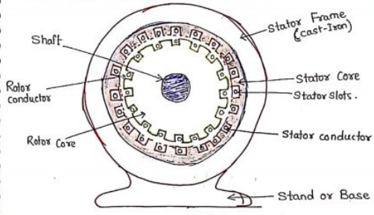
Construction of three phase induction motor
A three-phase induction motor consists of two main parts namely,
Stator
Rotor
There is a small air gap between the stator and rotor which ranges from 0.4 mm to 4 mm depending on the power rating of the motor.

Slide 4
Stator
The stator of a three-phase induction motor is a stationary part.
It consists of following parts,
Stator frame: It is made up of cast-iron and holds the stator core.
Stator core: It is made up of thin sheets of steel lamination stacked together. Stator core has slots for providing three-phase ac windings in it.
Stator winding( three phase winding): These windings consists of insulated copper wire. The three phase are connected in either star or delta fashion. Stator winding are done for specific number of poles, as per requirement.
Ns= 120f/p
When a 3 phase ac supply is given to the stator winding a rotating magnetic field is set up in space
Thus the rotating magnetic field induces emf in the rotor by electromagnetic induction, that produces torque , resulting in rotation of motor.

Slide 5
The air gap between the stator and rotor needs to be small as practically possible.
It reduces the leakage flux between stator and rotor
It improves the operating power factor of induction motor.
Rotor
The rotor is a rotating or moving part of the three-phase induction motor.
It consists of a rotor core made up of thin laminations of high grade silicon steel to reduce the hysteresis and eddy-current losses. The rotor core is a hollow cylinder, mounted on a shaft. On outer periphery of the rotor core, slots are provided to place the rotor winding.
Based on the construction, the rotor of a three-phase induction motor can be of the following two types −
Squirrel-cage rotor
Wound rotor

Slide 6
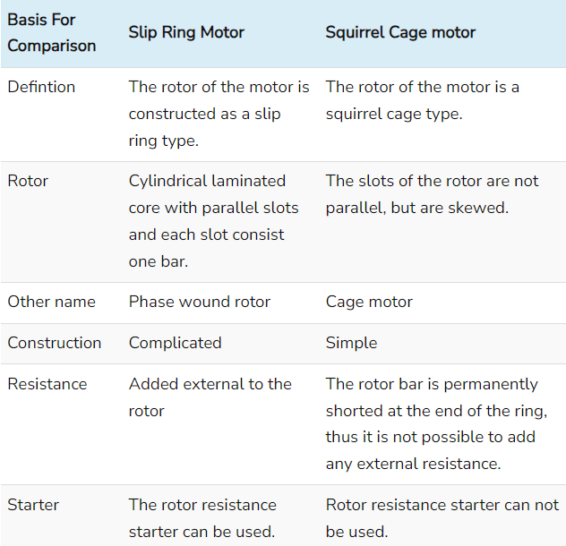
Difference between Squirrel cage and Wound rotor

Slide 7
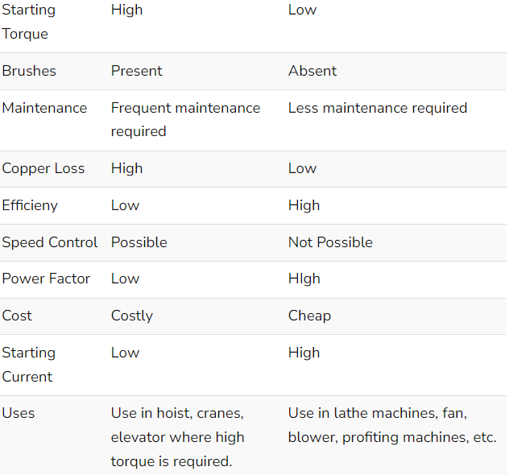

Slide 8
Principle of operation of induction motor
Induction motor works on principle of electromagnetic induction.
When 3 phase supply is given to 3 phase stator winding, a rotating magnetic field is created, along with stator flux
The rotating magnetic field cuts the rotor conductor, inducing an EMF in it as per Faradys law of electromagnetic induction.
The induced EMF causes a current to flow in the rotor as rotor circuit is short circuited.
The induced current in rotor will also produce alternating flux around it. Besides, rotor flux lags behind the stator flux as dictated by Lenz law(rotor flux will tend to oppose the cause of producing it i.e. stator flux.)
Here, the cause of production of rotor current is the relative velocity between rotating stator flux and the rotor,
The rotor will try to catch up with the stator rotating magnetic field. Thus the rotor rotates in the same direction as that of stator flux to minimize the relative velocity.
However, the rotor never succeeds in catching up the synchronous speed. This is the basic working principle of induction motor of either type, single phase of 3 phase.

Slide 9


The rotational speed of the rotating magnetic field is called as synchronous speed.
where, f = frequency of the supply
P = number of poles
Slip:
Rotor tries to catch up the synchronous speed of the stator field, and hence it rotates.
But in practice, rotor never succeeds in catching up.
If rotor catches up the stator speed, there wont be any relative speed between the stator flux and the rotor, hence no induced rotor current and no torque production to maintain the rotation.
That is why the rotor rotates at speed which is always less the synchronous speed.
The difference between the synchronous speed (N_{s}) and actual speed (N) of the rotor is called as slip.

Slide 10
Applications of 3-Phase Induction Motor
A three-phase induction motor might be used to power a centrifugal pump that moves crude oil from wells to pipelines or storage tanks.
It is used to drive a compressor that pressurizes natural gas for transportation or storage.
It is used to run a turbine that generates electricity for offshore platforms or remote locations.
It is used to power a pump that moves liquids through distillation columns or catalytic crackers.
It is used to drive a compressor that increases the pressure of gases for further processing or separation.
It is used to drive a transformer that converts high voltage from power plants to lower voltage for transmission lines or vice versa.
It is also used to operate a switchgear that connects or disconnects circuits for protection or control purposes.
Induction motors are versatile and widely used AC electric motors that operate on the principle of electromagnetic induction.
They have different types, such as squirrel cages or slip rings, and different applications, such as pumps, fans, compressors, conveyors, cranes, elevators, and more.

